Slide 1
Steve Smyth Director New Southern Sky Performance Based Navigation (PBN) Implementation in New Zealand

Slide 2
Aim
To bring you ‘up to date’ with how Performance Based Navigation is being implemented in New Zealand

Slide 3
Scope
Introduction – the Global and National perspective
Where NZ is heading with PBN
The benefits
The PBN journey – where are we today?
GA and PBN – In the margins?
The future – Satellite Based Augmentation System – dream or reality?

Slide 4
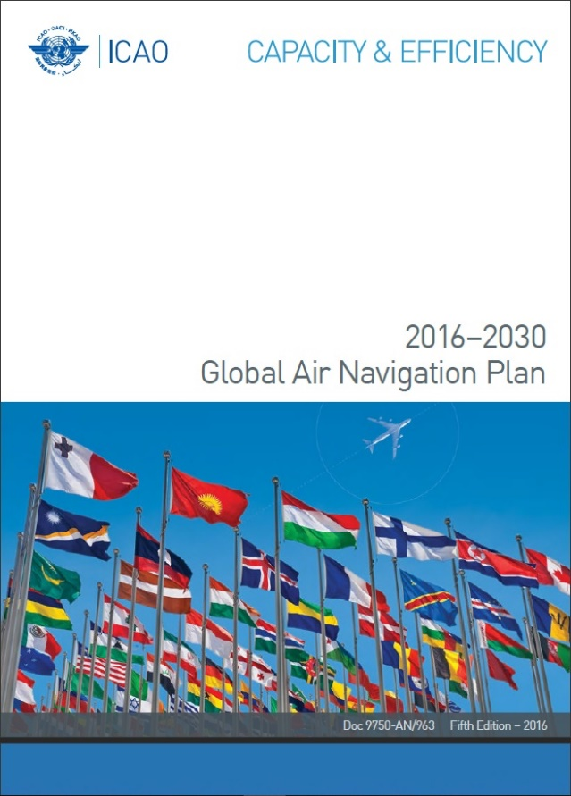
The Global Perspective
Global Air Navigation Plan – sustaining and growing the benefits of air travel - Priority for ICAO – rolling out PBN
Why – to reduce emissions, sustain and improve safety, make air travel cheaper and more accessible to people
We are part of the global community – PBN isn’t simply a local initiative – but why is it relevant to GA?

Slide 5
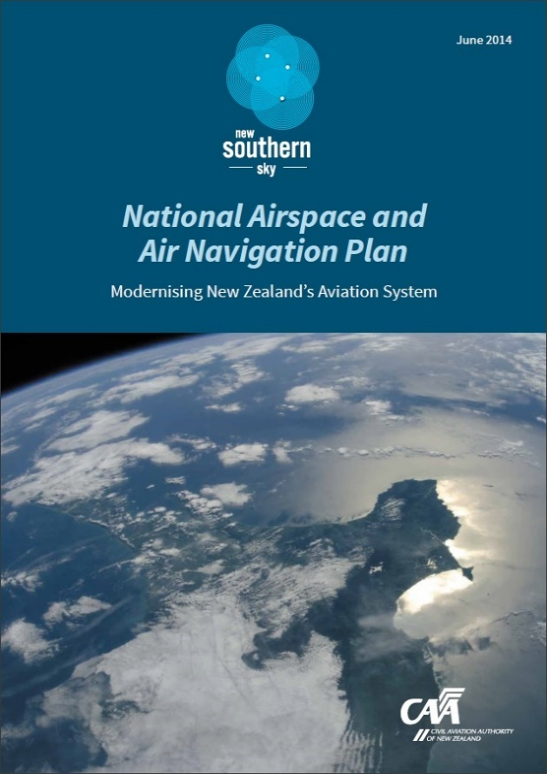
The National Perspective
PBN is part of a wider national plan, the ‘NAANP’ which is already delivering safety, environmental, economic and social benefits to everyone in New Zealand through NSS
PBN is the primary driver delivering benefits
Whole of aviation system involved – not just airlines and major airports – part of a wider national system
Benefits to communities include:
improving the ability of medical flights and helicopter rescue flights to access small airports and accident sites and deliver critically ill patients directly to hospital in poor weather
Providing air access and aviation support to communities during emergencies e.g. earthquakes

Slide 6
Where New Zealand is heading with PBN
ICAO Assembly Resolution A36-23
PBN will be the primary means of navigation in NZ
Moving away from conventional ground-based navigation-aids to satellite-based navigation aids
GNSS (GPS) is the navigation service for deployment of PBN in New Zealand
New Zealand is aiming for a full PBN operational environment by 2023

Slide 7
Enablers
PBN Implementation Plans – 2009/2017
PBN roll-out controlled aerodromes - 2009
PBN regulatory framework project - underway
Education
‘Approach’ PBN forum
NSS website - videos
NSS Roadshows – discussions and advice
NSS Conference workshop – 15/16 May Auckland

Slide 8
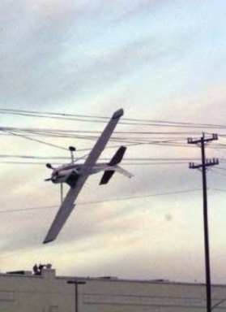
Safety Benefit Analysis
Instrument approaches with lateral guidance 25 times safer than circling/visual approaches
PBN procedures facilitate traffic flow – reduce conflict between aircraft and holds/diversions (ADS-B and ATM are part of this)
Approaches with vertical guidance (APV) 8 times safer than legacy non-precision approaches
Since PBN implementation in NZ, and additional 2.2 million passengers protected by vertical guidance

Slide 9
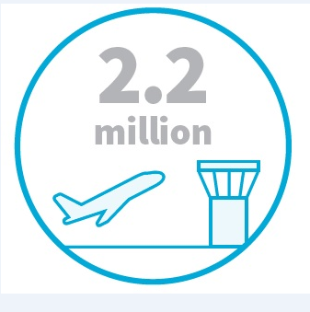
Benefits being delivered
SAFETY - 2.2M more passengers per year in the network protected by vertical approach component
ENVIRONMENT - 4.8 Million Kg less CO2

Slide 10
APV by the numbers

Slide 11
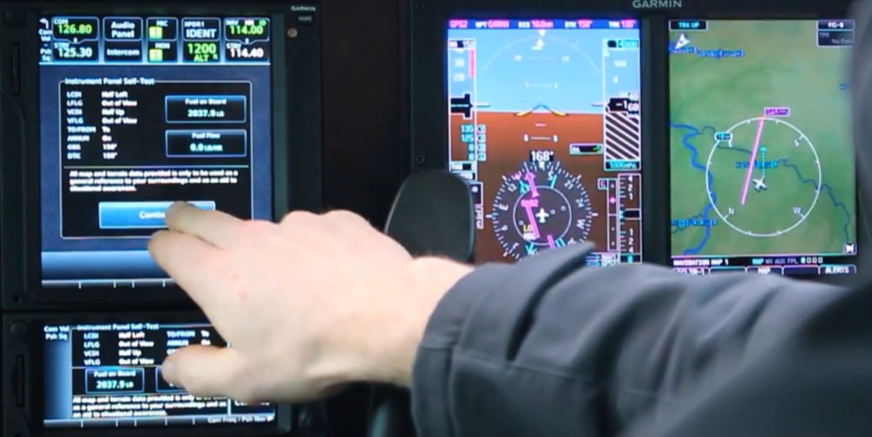
How does GA Fit into this picture?
Is GA on the margins of all this? Why should GA matter?

Slide 12
How does GA Fit into this picture?
Is GA on the margins of all this? Why should GA matter?
GA is where commercial pilots are grown
PBN training has to be provided by training organisations
If conventional means of navigation is only a back-up (the MON) GA IFR needs to adopt PBN
GA needs to be part of the PBN system, not an impediment
There are a host of new air vehicles entering the system – PBN is a good way to integrate and stay safe

Slide 13
Benefits to GA
If you need/want to fly IFR, PBN is safer
It can save you time – equipped and ready – ATC will feed you in for your approach
Accurate and predictable – avoid those new hazards
Flexible use of airspace – training sand-pits

Slide 14
Challenges
Availability of procedures in NZ – what happens after the controlled aerodrome PBN roll-out is complete?
GA pilot mindset – not new, but requires systematic application – need to tune in
Apparent complexity – greater familiarity with flight manual/GPS operations manual required to ensure that Human Factors don’t bite you

Slide 15
The Future - SBAS Test-bed
Testing 3 new technologies, funded jointly by the Australian and New Zealand Governments ($12M/$2M)
Geoscience Australia, in partnership with Land Information New Zealand (LINZ) and the Cooperative Research Centre for Spatial Information (CRCSI)
Working with:
10 industry sectors
30 organisations and businesses
Aim - to identify the benefits

Slide 16
SBAS Benefits to Aviation
SBAS assisted approaches are 8 times safer than approaches that use ground-based navigation aids
SBAS technology will decrease the likelihood that flights will be cancelled or diverted due to weather, or that multiple attempts at landing will be required
SBAS provides both safety and efficiency benefits for suitably equipped aircraft, particularly those aircraft operating into regional and remote aerodromes

Slide 17
SBAS Technical Information
Three technologies are being trialled, first generation SBAS, second generation SBAS and Precise Point Positioning (PPP).
First generation SBAS technology improves positioning accuracy to within half a metre. PPP (experimental) potentially ten centimetres.
First time anywhere in the world that second generation SBAS signals have been transmitted.
The new technologies augment and correct GPS and Galileo signals, improving accuracy, integrity, continuity and availability.
Ernst and Young have been contracted to conduct an independent evaluation of the economic and social benefits of SBAS for the Australasian region.

